Slide 1
Console input

Slide 2
Outline
In this lesson, we will:
  Learn how to request data from the console
  Introduce streams and review whitespace
  Look at entering characters, integers, floating-point numbers and Boolean types
  Introduce the string class
  See how to read in strings

Slide 3
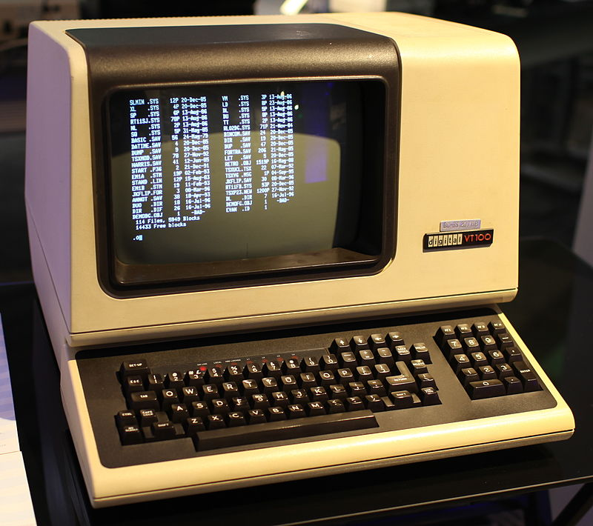
Background
Previously, we’ve seen how we can print data to the screen:
std::cout << "Hi " << 3 << ',' << 3.14 << std::endl;
How do we get data from the keyboard?
  Previously, a console was often a single unit
  consisting of both a keyboard and screen
  Console input is from the keyboard
  Console output is to the screen
Jason Scott

Slide 4
Background
The << operator appears to be directing data to the console output:
std::cout << "Hi " << 3 << ',' << 3.14 << std::endl;
To request data from the keyboard, we use std::cin
Any data received from the console must be temporarily stored
  We will use local variables
The >> operator appears to be directing data from the console to the variable:
typename x{}; // Use default value, just in case
std::cin >> x;

Slide 5
Background
For example:
  int main() {
  int m{};
  std::cout << "Enter an integer: ";
  std::cin >> m;
  if ( m < 0 ) {
  std::cout << m << " is less than 0." << std::endl;
  } else if ( m == 0 ) {
  std::cout << "You entered 0." << std::endl;
  } else {
  std::cout << m << " is greater than 0." << std::endl;
  }
  }

Slide 6
Background
Try it yourself:
  #include <iostream>
  // Function declarations
  int main();
  // Function definitions
  // Request the user enter a number and the describe it relative to zero
  int main() {
  int m{};
  std::cout << "Enter an integer: ";
  std::cin >> m;
  if ( m < 0 ) {
  std::cout << m << " is less than 0." << std::endl;
  } else if ( m == 0 ) {
  std::cout << "You entered 0." << std::endl;
  } else {
  std::cout << m << " is greater than 0." << std::endl;
  }
  }

Slide 7
Background
May appear peculiar
  Characters are only processed once the user presses Enter
  The characters are internally stored in the order they arrive
    As you keep typing, any more characters are added to the end of the stream
 | H | i | ! | → | I | ' | l | l |  | t | a | k | e |  | 3 | ↵ |  |  | · · ·

Slide 8
Characters
Depending on the type of the variable, std::cin will attempt to satisfy the request
char ch{};
std::cin >> ch;
It will assign to ch the first non-whitespace character
  In this case, 'H'
Whatever value was previous assigned to ch is lost
 | H | i | ! | → | I | ' | l | l |  | t | a | k | e |  | 3 | ↵ |  |  | · · ·
i | ! | → | I | ' | l | l |  | t | a | k | e |  | 3 | ↵ |  |  |  |  | · · ·

Slide 9
Integers
If you request an integer, it will start looking for decimal digits and interpret it as a base-10 number
int m{};
std::cin >> m;
It stops if it finds a non-decimal-digit
  If no other digits were found, it assigns m the value 0
i | ! | → | I | ' | l | l |  | t | a | k | e |  | 3 | ↵ |  |  |  |  | · · ·
i | ! | → | I | ' | l | l |  | t | a | k | e |  | 3 | ↵ |  |  |  |  | · · ·

Slide 10
Integers
Suppose, instead, after this statement executes, the user actually typed something that starts with digits
int m{};
std::cin >> m;
It finds 35240, assigns it to m and stops reading from the stream
3 | 5 | 2 | 4 | 0 | - | 1 | 5 | ↵ |  |  |  |  |  |  |  |  |  |  | · · ·
- | 1 | 5 | ↵ |  |  |  |  |  |  |  |  |  |  |  |  |  |  |  | · · ·

Slide 11
Other types
Floating-point numbers are similar to integers, only we can include a decimal point and possibly scientific notation
The Boolean type bool is different:
  It requires a numeric value: 0 or 1 followed by Enter or whitespace
  Anything else is considered an error, although the variable is set to true

Slide 12
Multiple inputs
The following requests two integers:
std::cout << "Enter two integers: ";
int m{}, n{};
std::cin >> m >> n;
Possible inputs include:
42 91↵
42 91↵
42↵
91↵

Slide 13
Strings
We have seen how to print strings:
std::cout << "Enter a word: ";
How do we read strings from the console? What type must str be?
std::cin >> str;
In C++, there is the string library, which contains a std::string class
  In addition to primitive types, variables can be defined to be of one of these classes
  The std::cin object is aware of this class

Slide 14
Strings
As an example:
    #include <iostream>
    #include <string>
    int main();
    int main() {
    std::string str{};
    std::cout << "Enter a word: ";
    std::cin >> str;
    std::cout << "You entered the word \"" << str << "\"."
    << std::endl;
    return 0;
    }

Slide 15
Strings
Try it yourself:
    #include <iostream>
    #include <string>
    // Function declarations
    int main();
    // Function definitions
    // Ask the user to enter a word and then print that word to the screen
    int main() {
    std::string str{};
    std::cout << "Enter a word: ";
    std::cin >> str;
    std::cout << "You entered the word \"" << str << "\"."
    << std::endl;
    return 0;
    }

Slide 16
Strings
When asking for a string, std::cin will:
  Ignore any leading whitespace characters
  Read in all non-whitespace characters, and
  Stop before the next whitespace character
Suppose you request a string:
std::cin >> str;
and the user enters this line:
The string str is assigned the string "Hello" and the stream is now:
H | e | l | l | o |  | w | o | r | l | d | ! | ↵ |  |  |  |  |  |  | · · ·
 | w | o | r | l | d | ! | ↵ |  |  |  |  |  |  |  |  |  |  |  | · · ·

Slide 17
Summary
Following this lesson, you now:
  Understand that one way to request data is through std::cin
  Are aware of input and output streams
  Know how to request the primitive datatypes from the user
    Whitespace is ignored
    Only characters that can be interpreted are
  Are aware of the std::string class and the standard string library

Slide 18
References
[1] No references?

Slide 19



Colophon
These slides were prepared using the Georgia typeface. Mathematical equations use Times New Roman, and source code is presented using Consolas.
The photographs of lilacs in bloom appearing on the title slide and accenting the top of each other slide were taken at the Royal Botanical Gardens on May 27, 2018 by Douglas Wilhelm Harder. Please see
https://www.rbg.ca/
for more information.

Slide 20
Disclaimer
These slides are provided for the ece 150 Fundamentals of Programming course taught at the University of Waterloo. The material in it reflects the authors’ best judgment in light of the information available to them at the time of preparation. Any reliance on these course slides by any party for any other purpose are the responsibility of such parties. The authors accept no responsibility for damages, if any, suffered by any party as a result of decisions made or actions based on these course slides for any other purpose than that for which it was intended.

